Slide 1
Employee Data Analysis using Excel
STUDENT NAME: VINODHA. P
REGISTER NO:CC43A00E6FE0DC481614343142FD4E68,312208816
DEPARTMENT:B. Com(GENERAL)
COLLEGE: MEENAKSHI COLLEGE FOR WOMEN

Slide 2
PROJECT TITLE
Employee Performance Analysis Based On Departments, Employee
Type And FTE using Excel

Slide 3


AGENDA
Problem Statement
Project Overview
End Users
Our Solution and Proposition
Dataset Description
Modelling Approach
Results and Discussion
Conclusion
3/21/2024 Annual Review

Slide 4

PROBLEM STATEMENT The purpose of Full-Time Equivalent (FTE) is to standardize the measurement of employee work hours,regardless of whether they work full-time or part-time, in order to better manage, allocate, and analyze workforce resources.

Slide 5

PROJECT OVERVIEW Employee analysis involves examining various aspects of the workforce to gain insights that can help in decision – making, improving efficiency, and enhancing employee satisfaction.
.

Slide 6

WHO ARE THE END USERS? ● HUMAN RESOURCE DEPARTMENTS ● MANAGEMENT AND LEADERSHIP ● TEAM LEADERS AND SUPERVISORS ● EMPLOYEES ● EXECUTIVE LEADERSHIP ● BUSINESS ANALYSTS ● RECRUITERS

Slide 7

OUR SOLUTION AND ITS VALUE PROPOSITION FILTERING- REMOVE VALUES PIVOT TABLE – SUMMARY OF EMPLOYEE PERFORMANCE BAR DIAGRAM – FINAL REPORT

Slide 8
Dataset Description ● EMPLOYEE DATA SET- NAN MUDHALVAN PORTAL ● 9 FEATURES IN EXCEL: EMPLOYEE ID- ALPHANUMERIC(TEXT) NAME- ALPHABETICAL(TEXT) GENDER- ALPHABETICAL(TEXT) DEPARTMENT – ALPHABETICAL(TEXT) SALARY – NUMERICAL START DATE – ALPHANUMERIC(TEXT) FTE- NUMERICAL EMPLOYEE TYPE- ALPHABETICAL(TEXT) EMPLOYEE LOCATION- ALPHABETICAL(TEXT) ● 3 FEATURES USED: DEPARTMENT – ALPHABETICAL(TEXT) FTE- NUMERICAL EMPLOYEE TYPE- ALPHABETICAL(TEXT)

Slide 9

THE "WOW" IN OUR SOLUTION ❖ Effective data visualization makes it easier to present complex data in an engaging and understandable way. ❖ Well-presented data can have a significant impact on decision-makers, helping to drive change and innovation.
3/21/2024 Annual Review
9

Slide 10
MODELLING
● STEP -1 DOWNLOAD THE EMPLOYEE DATASET
AND OPEN THE EMPLOYEE DATASET IN EXCEL.
● STEP -2 SELECT THE ENTIRE DATA AND CLICK
ON DATA AND CLICK ON FILTER OPTION.
● STEP -3 FILTER FTP FROM A TO Z ORDER.
● STEP -4 SELECT THE ENTIRE DATA AND CLICK
ON INSERT AND CLICK ON PIVOT TABLE TO
CREATE PIVOT TABLE.
● STEP -5 DRAG THE NEEDED DATA AND CREATE A
PIVOT TABLE.
● STEP -6 SELECT THE PIVOT TABLE AND CLICK ON INSERT.
● STEP-7 NOW CLICK ON THE CHART THAT YOU WANT.
● STEP -8 THE CHART IS CREATED.
10

Slide 11
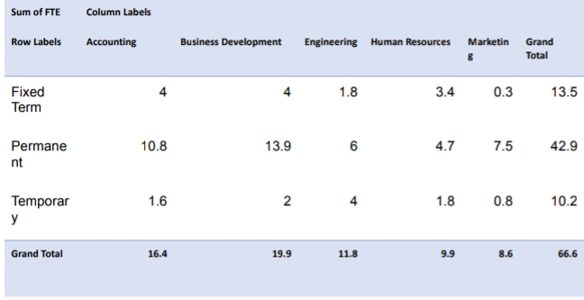
RESULTS 1.TABLE
11

Slide 12
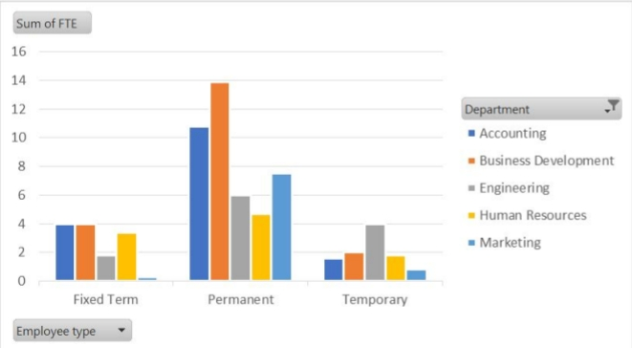
2. BAR DIAGRAM

Slide 13
Conclusion The dataset reveals the overall composition of the workforce, including demographics such as gender, salary, employee type and work location. This information is crucial for understanding the diversity and experience level within the organization. The analysis aids in workforce planning by forecasting future staffing needs based on current trends and organizational growth projections. This restructuring the workforce.

